Slide 1
Installing Jupyter Notebook for Spark
Arnaud.nauwynck@gmail.com

Slide 2
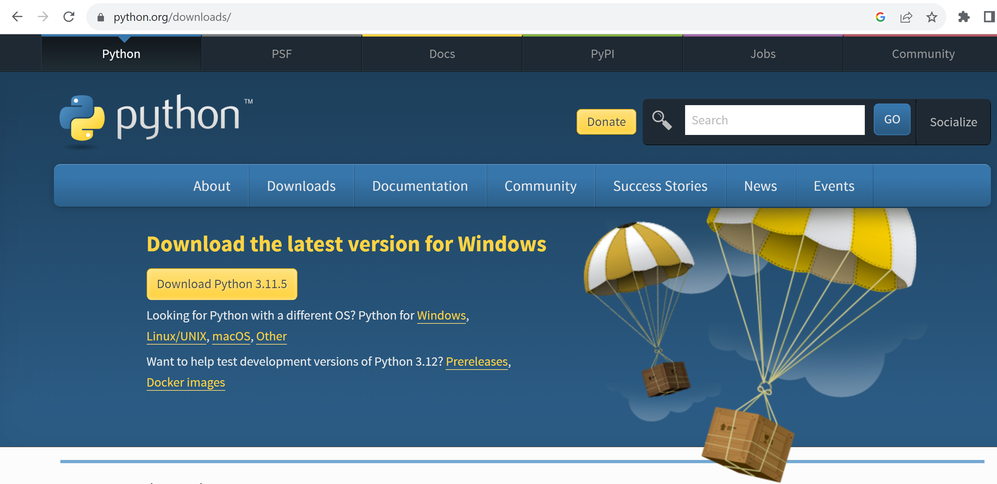
Step 1 : install python (simplest method, not using AnaConda)

Slide 3
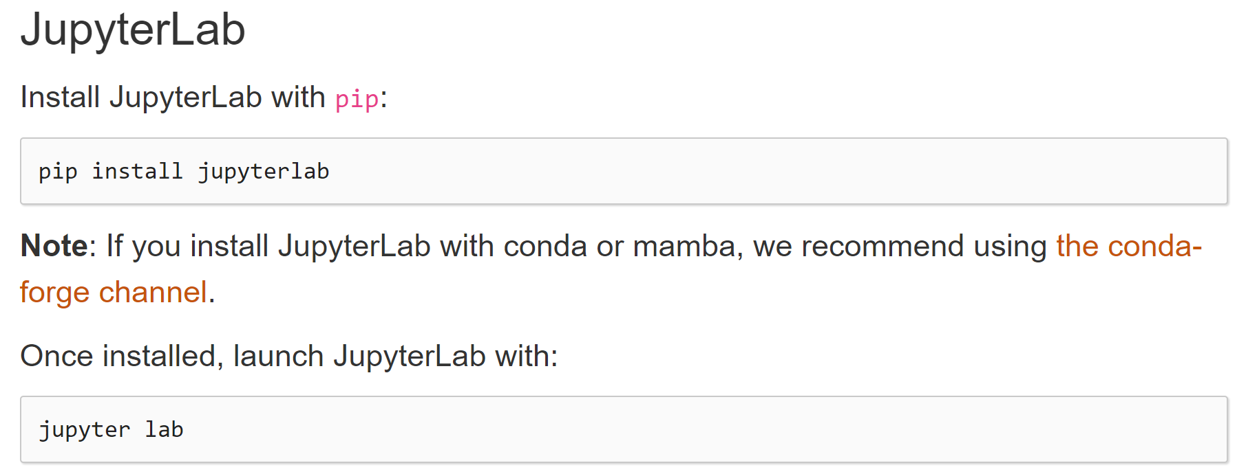
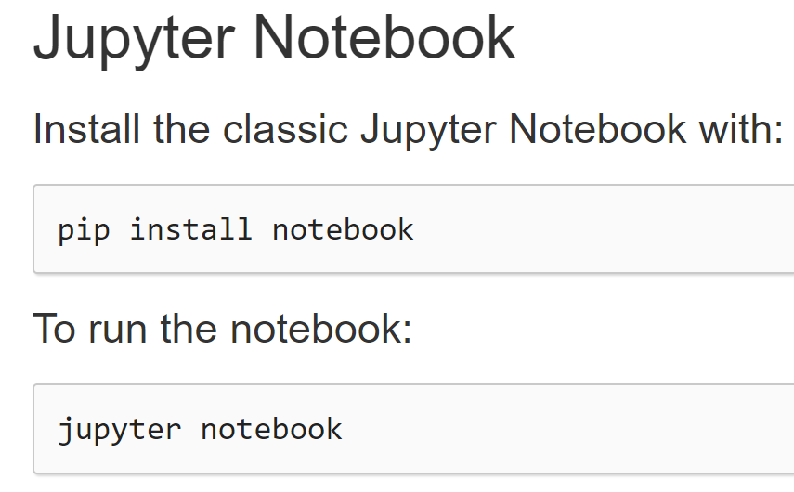
Step 2 : install jupyter
Choose class Jupyter Notebook… OK

Slide 4
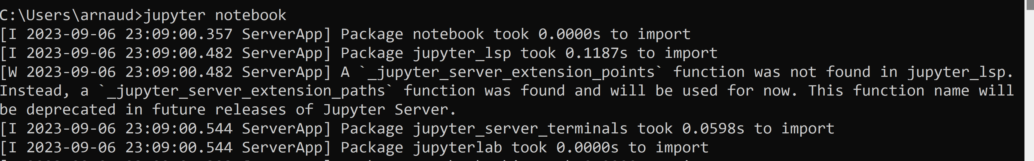
Star Jupyter Notebook
jupyter notebook
[[truncated logs …. Also contains errors?? ]]

Slide 5
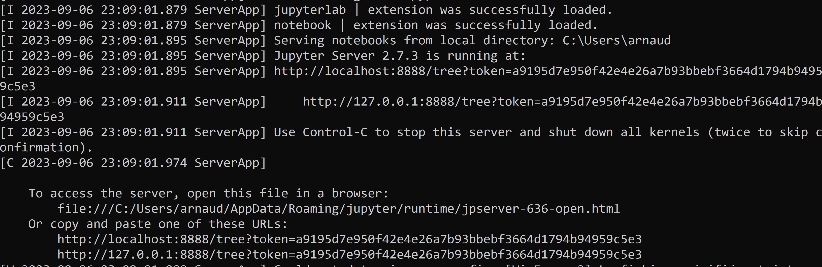
Jupyter Notebook ..

Slide 6
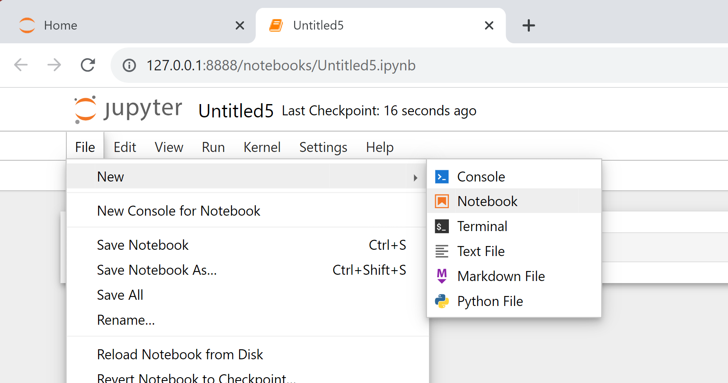
Creating a new notebook

Slide 7
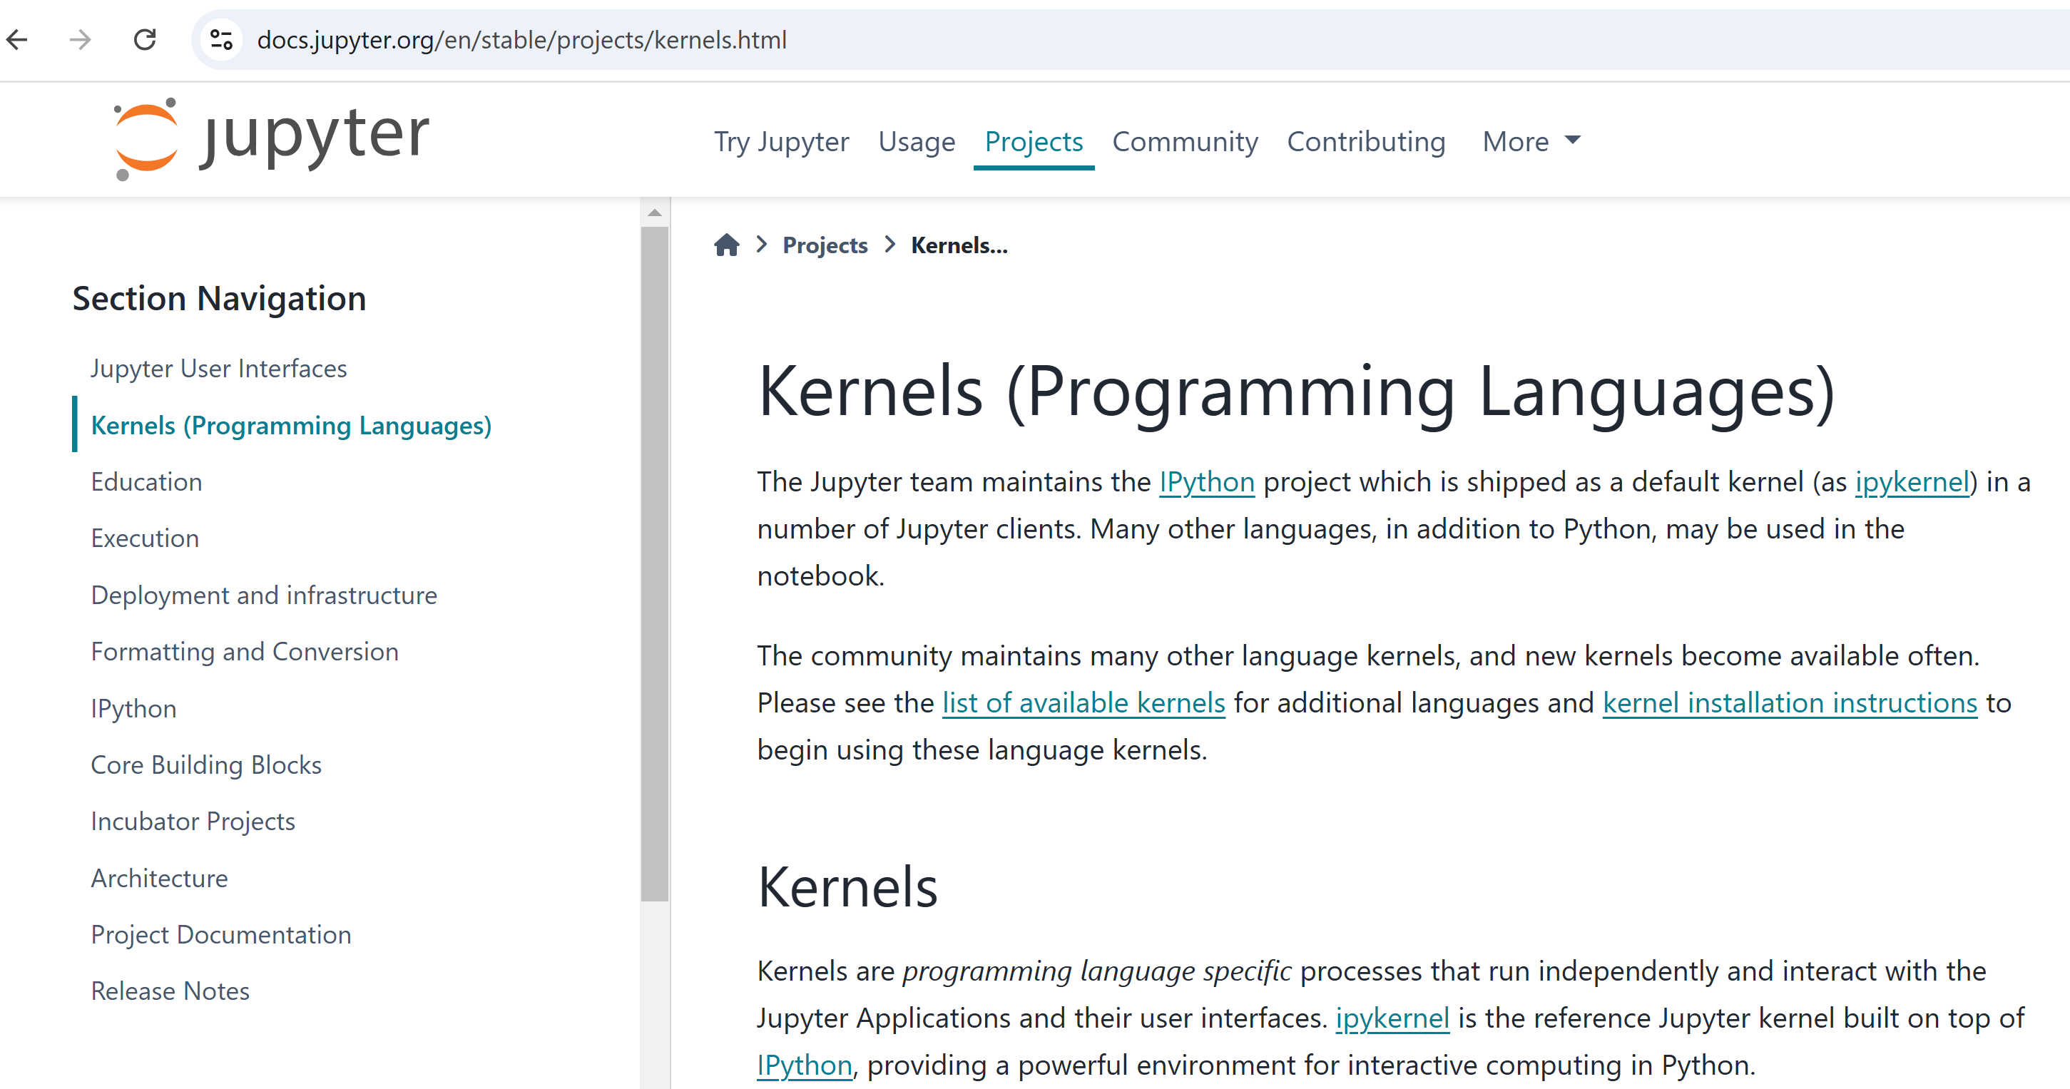
Step 3: jupyter needs kernels

Slide 8
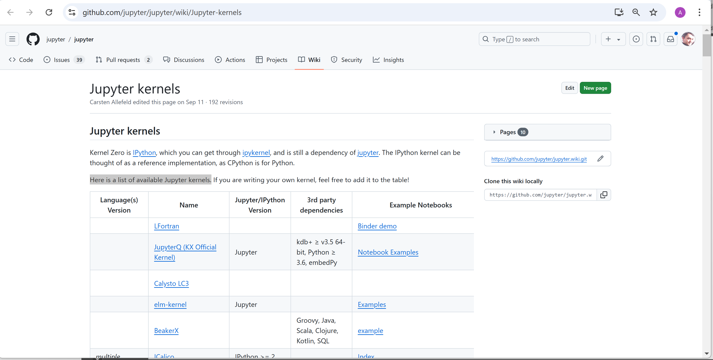
Step 3: list of community jupyter-kernels

Slide 9
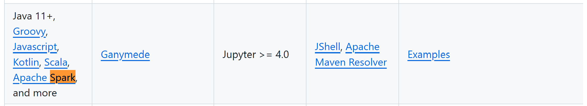
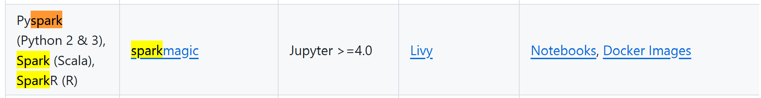



Jupyter Kernels "*spark*"

Slide 10
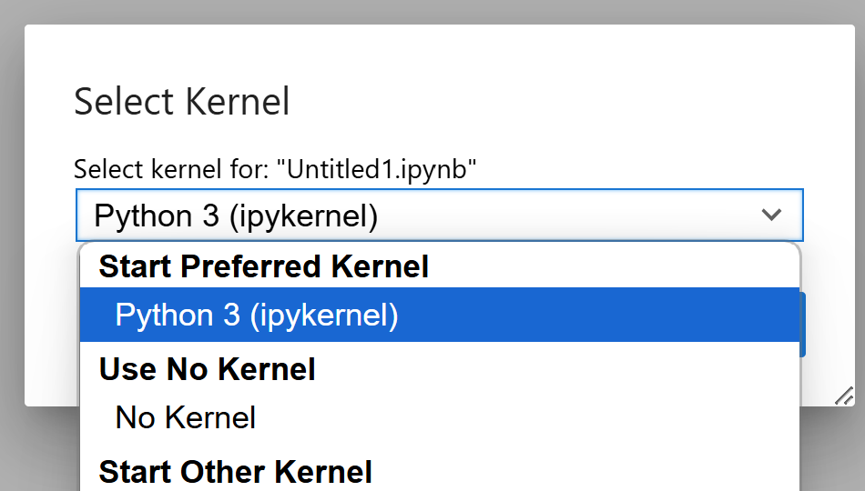
Jupyter Kernel(s)
to execute python
>>> 1+1
to execute spark python code
>>> spark.sql("...")
to execute spark scala code
scala> spark.sql("...")
to execute spark scala code
scala> spark.sql("...")
to execute scala (no spark)
scala> 1+1
ipykernel (built-in)
spylon kernel
(deprecated?)
almond kernel
pyspark ...
toree kernel
to execute spark scala code
scala> spark.sql("...")
does not work on windows
support only spark version 2
almond kernel + module "almound-spark"

Slide 11
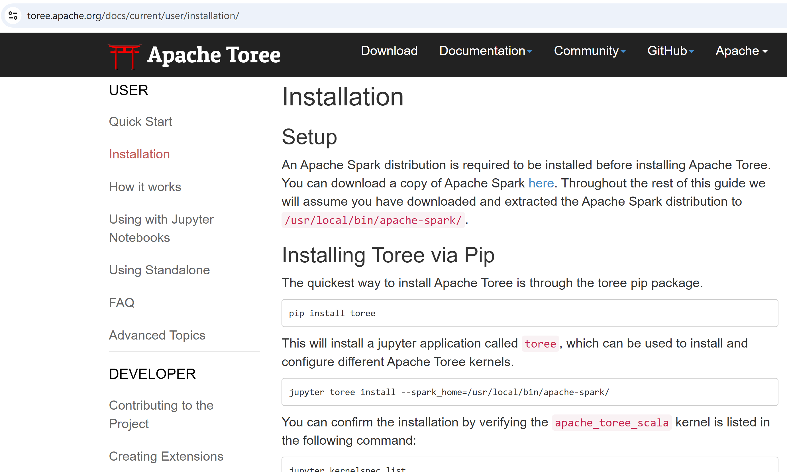
Step 3 alternative : Apache Toree

Slide 12
Install Toree
c:> pip install toree
c:> jupyter toree install --spark_home=%SPARK_HOME%

Slide 13
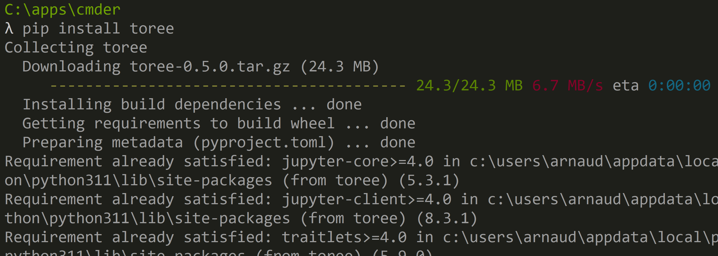
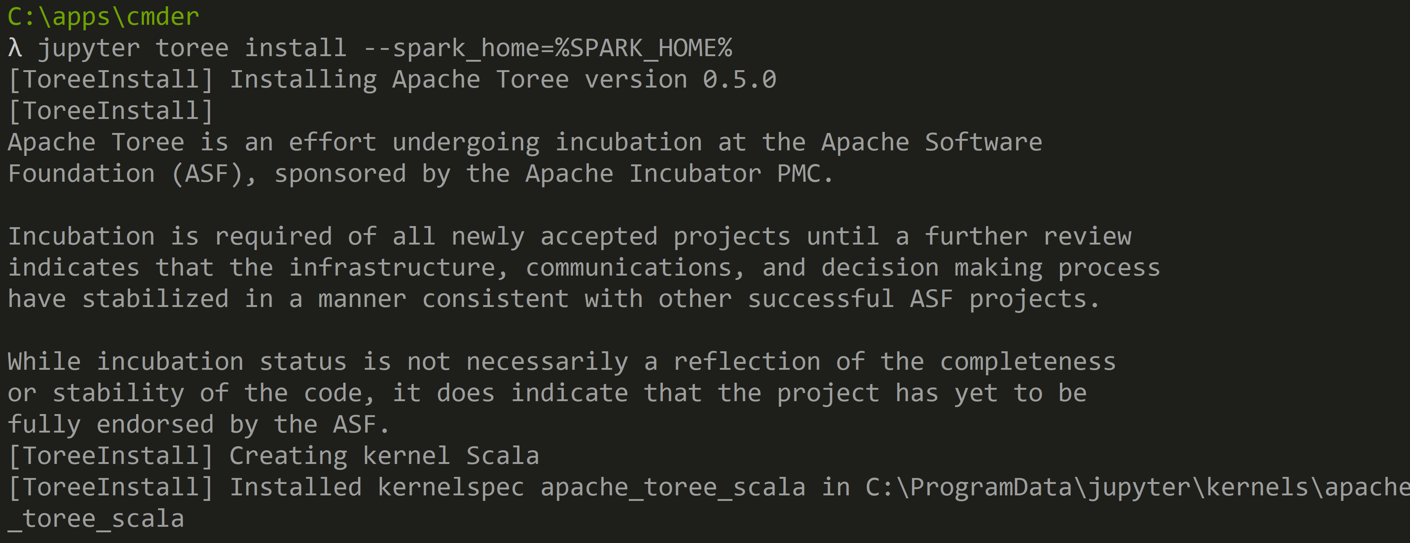
Toree

Slide 14
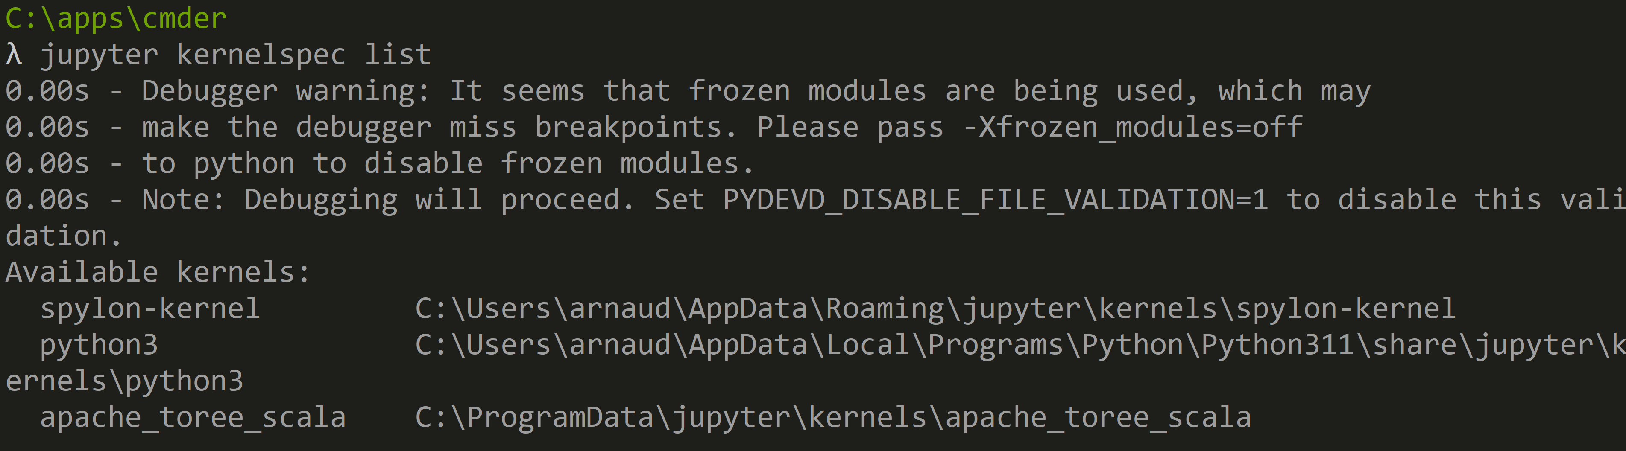
Check Toree install
to check:
c:> jupyter kernelspec list

Slide 15
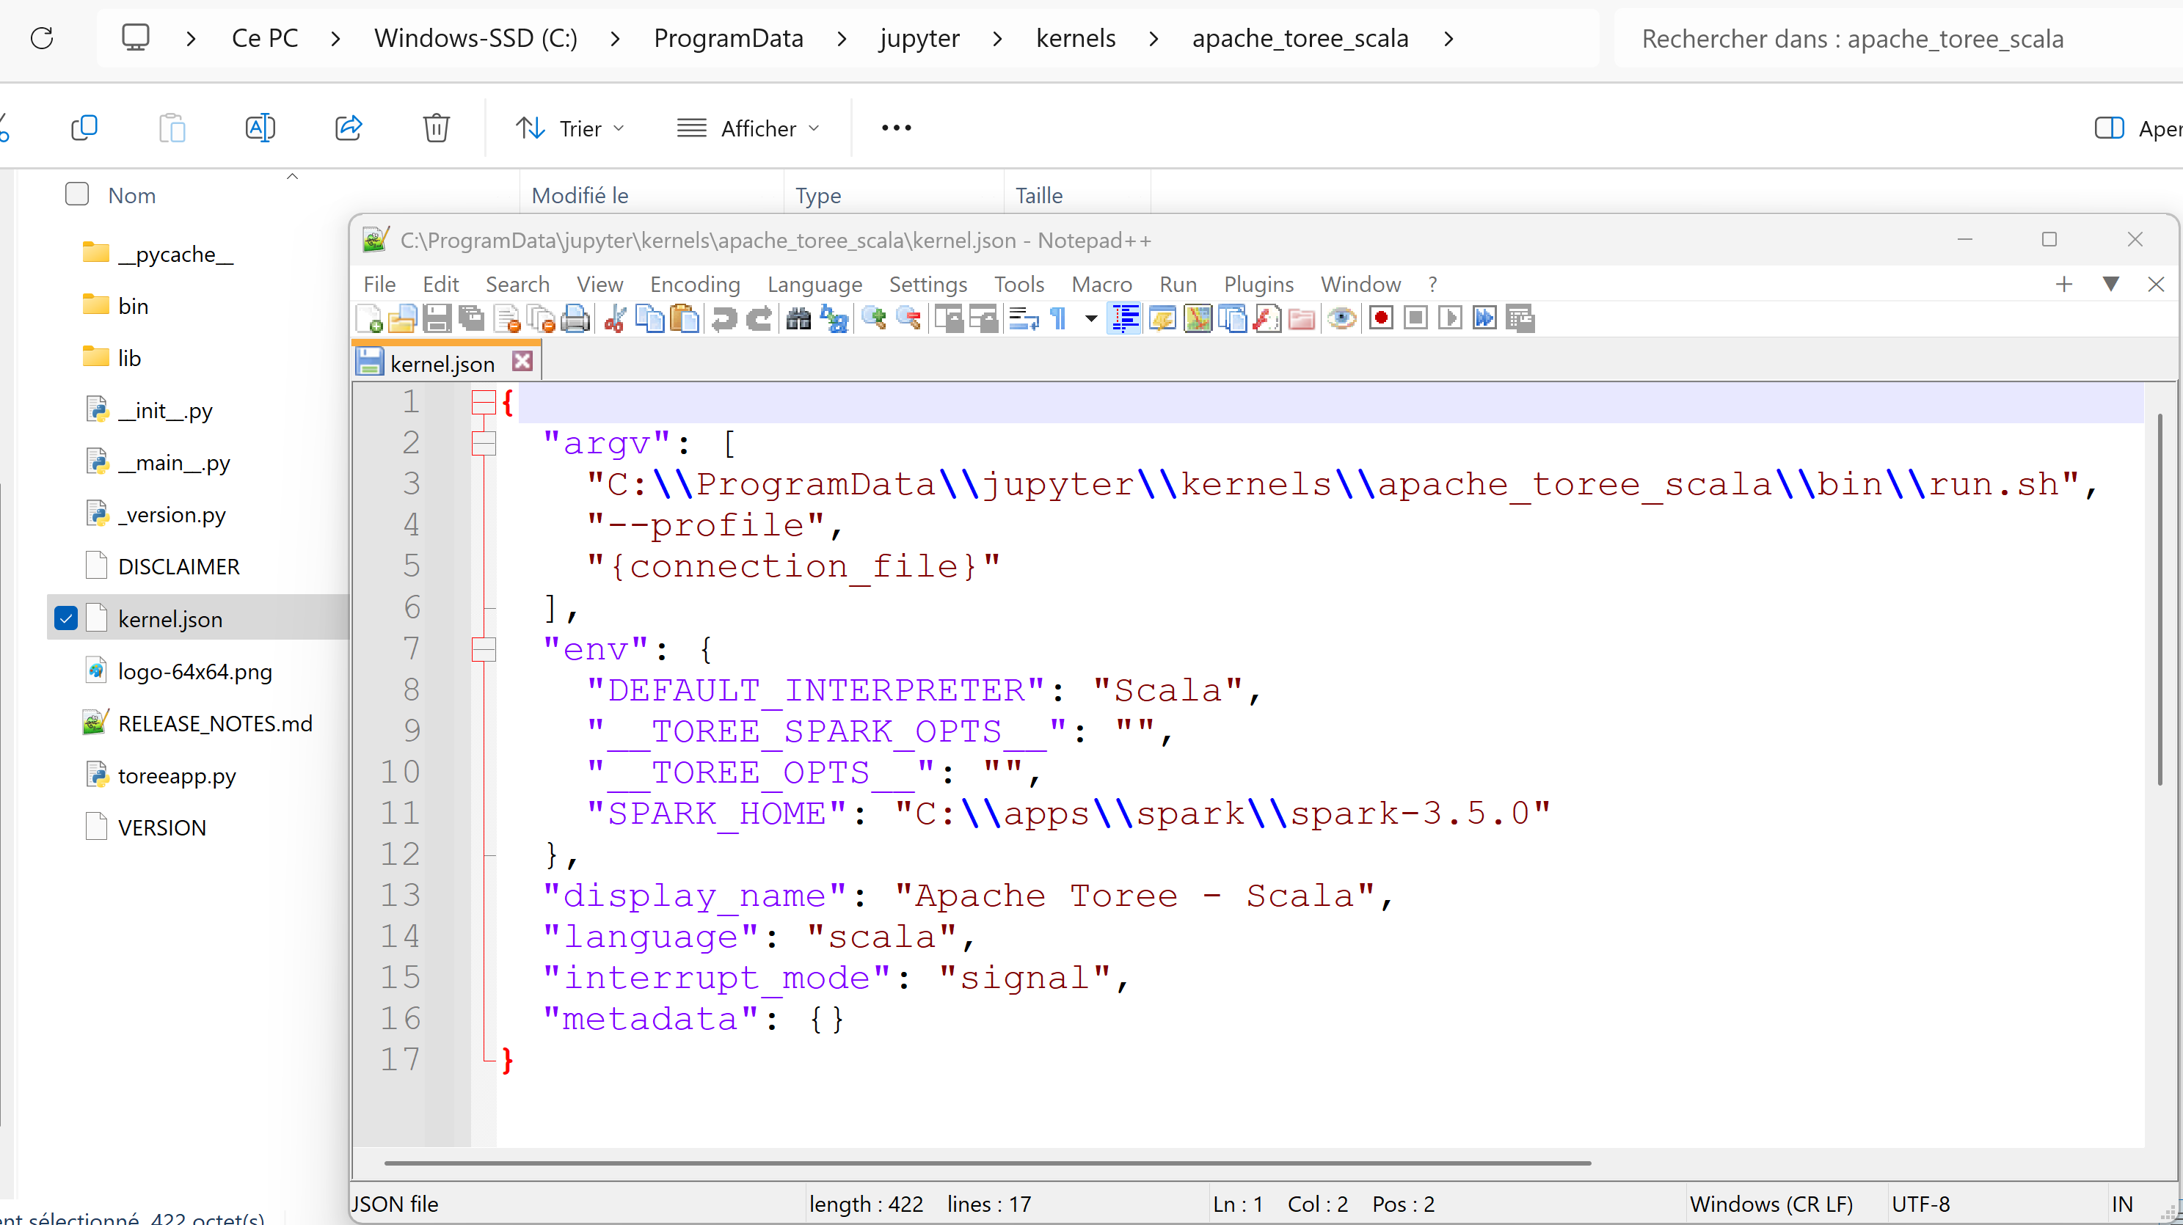
Toree for windows?? "run.sh" => "run.cmd"

Slide 16
Toree run.cmd
echo "... executing Toree/run.cmd"
echo
set PROG_HOME=C:\ProgramData\jupyter\kernels\apache_toree_scala
set TOREE_ASSEMBLY=%PROG_HOME%\lib\toree-assembly-0.5.0-incubating.jar
set PYTHONHASHSEED=0
set _JAVA_OPTIONS=-Dscala.usejavacp=true
if "%SPARK_OPTS%"=="" set SPARK_OPTS=%__TOREE_SPARK_OPTS__%
if "%TOREE_OPTS%"=="" set TOREE_OPTS=%__TOREE_OPTS__%
echo JAVA_HOME: %JAVA_HOME%
echo SPARK_HOME: %SPARK_HOME%
echo HADOOP_HOME: %HADOOP_HOME%
echo TOREE_ASSEMBLY: %TOREE_ASSEMBLY%
echo ... "%SPARK_HOME%\bin\spark-submit" --name "Apache-Toree" ^
%SPARK_OPTS% --class org.apache.toree.Main "%TOREE_ASSEMBLY%" %TOREE_OPTS% %*
"%SPARK_HOME%\bin\spark-submit" --name "Apache-Toree" ^
%SPARK_OPTS% --class org.apache.toree.Main "%TOREE_ASSEMBLY%" %TOREE_OPTS% %*

Slide 17
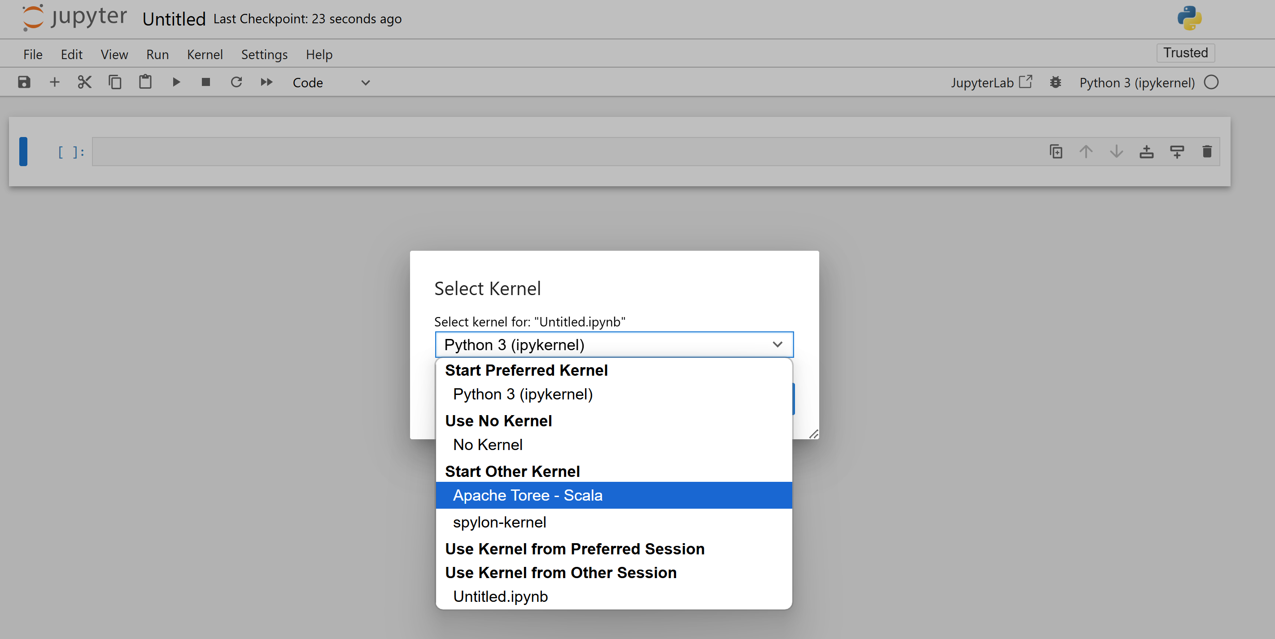
new Notebook > change Kernel

Slide 18
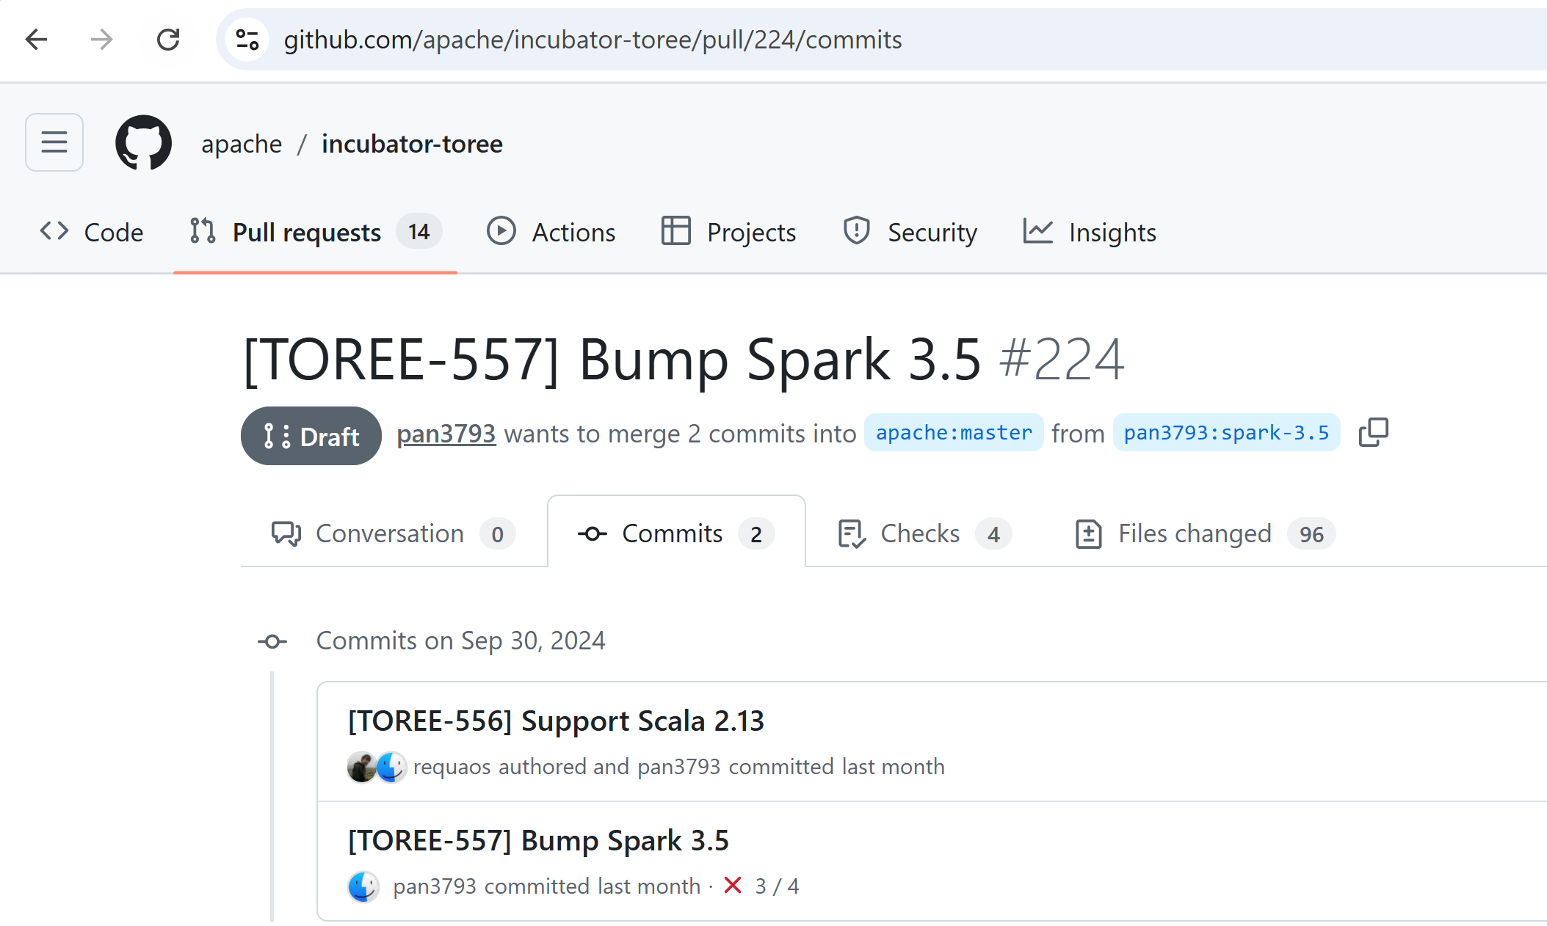
ERROR ... as of version 0.5, Toree support only Spark 2 !! for spark 3.5 with scala 2.13 => need to patch + recompile yourself !!
have to wait (or contribute more)
to this PullRequest

Slide 19
Step 3 alternative : almond kernel + "almound-spark" module for using spark with scala langage

Slide 20
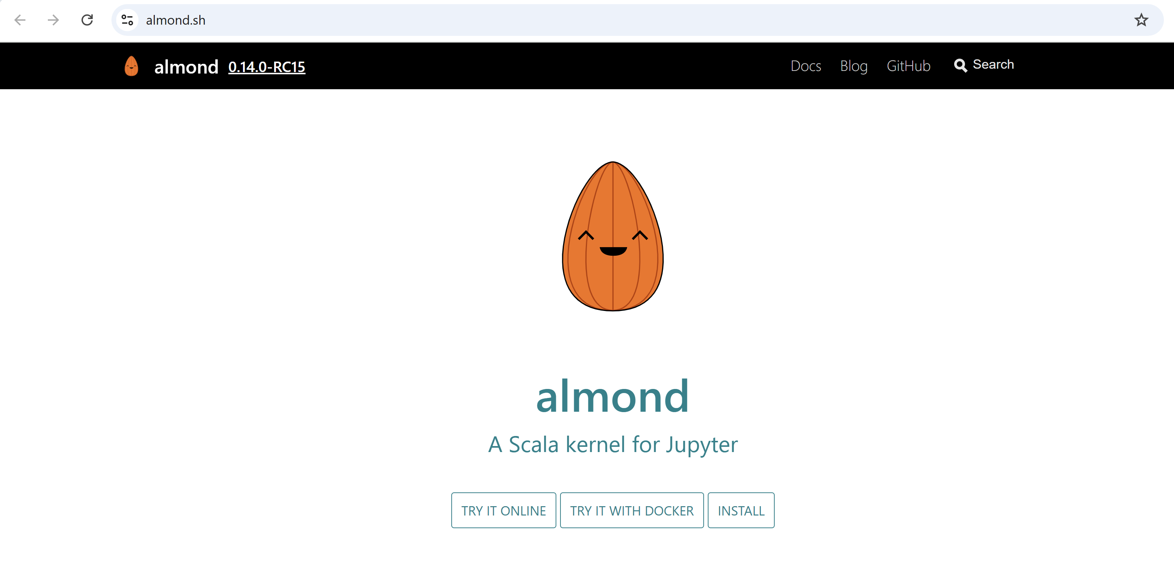
http://almond.sh

Slide 21
Install Almond

Slide 22
TODO ... WORK IN PROGRESS

Slide 23
Step 3 alternative : spylon kernel for spark + scala

Slide 24
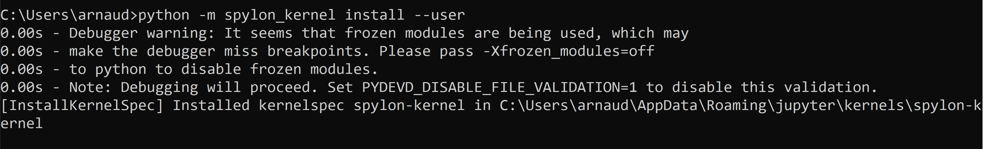
Step 3 alternative : install jupyter spylon_kernel (for using Spark with Scala langage)
python –m spylon_kernel install --user
(or pip install spylon_kernel –user )

Slide 25
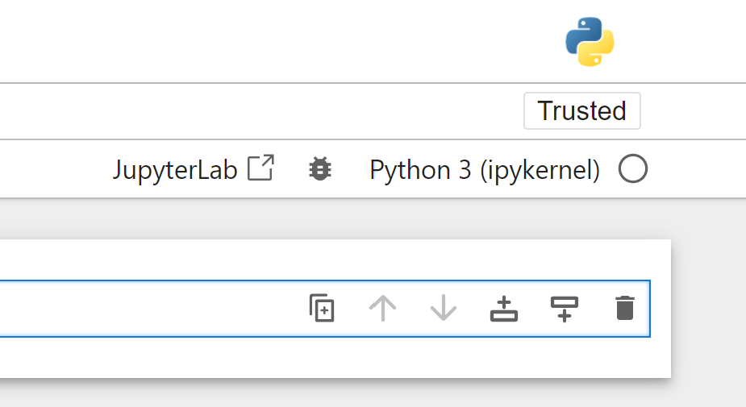
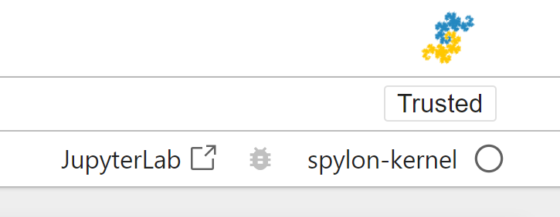
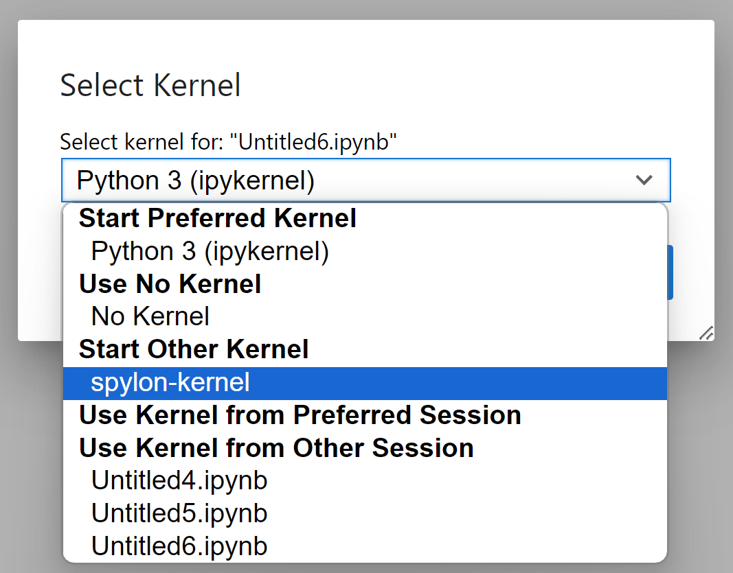
Step 3 … testing spylon

Slide 26
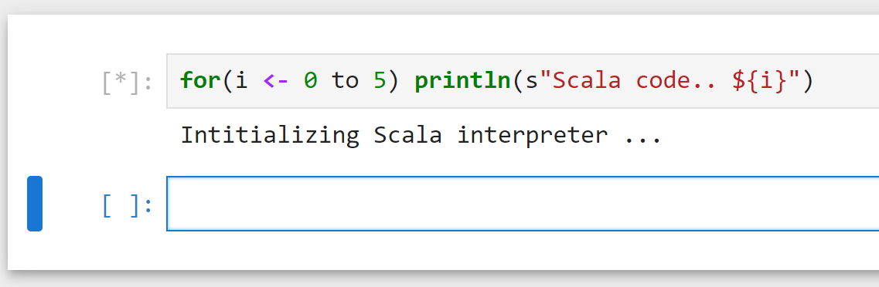
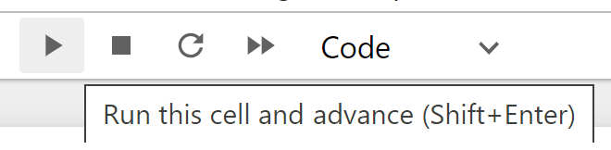
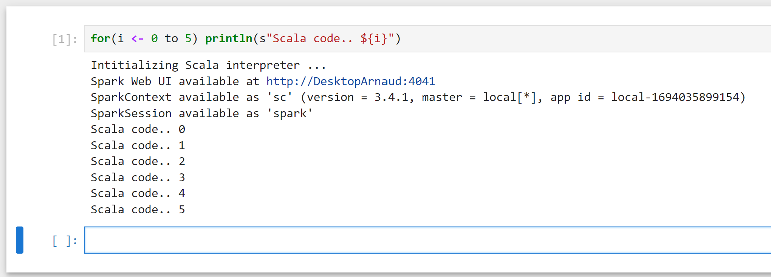
Step 3 … Testing Spylon .. Write Scala
Type SCALA code … Shift+Enter
Get Spark process (Scala interpreter)

Slide 27
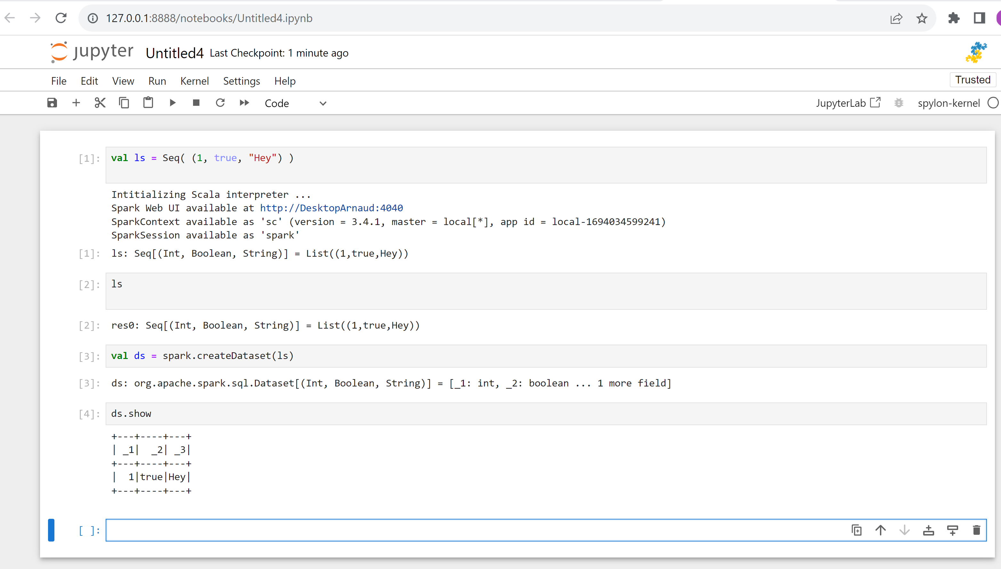
Step 3 … Testing Spylon .. Write Scala

Slide 28
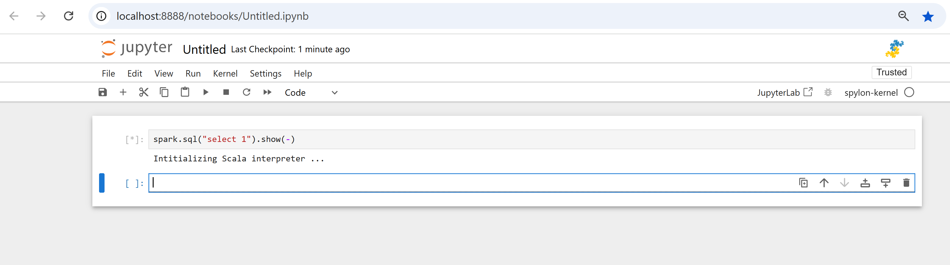
Spark SQL "Hello World"
may take 1 minute to start ... spark is starting

Slide 29
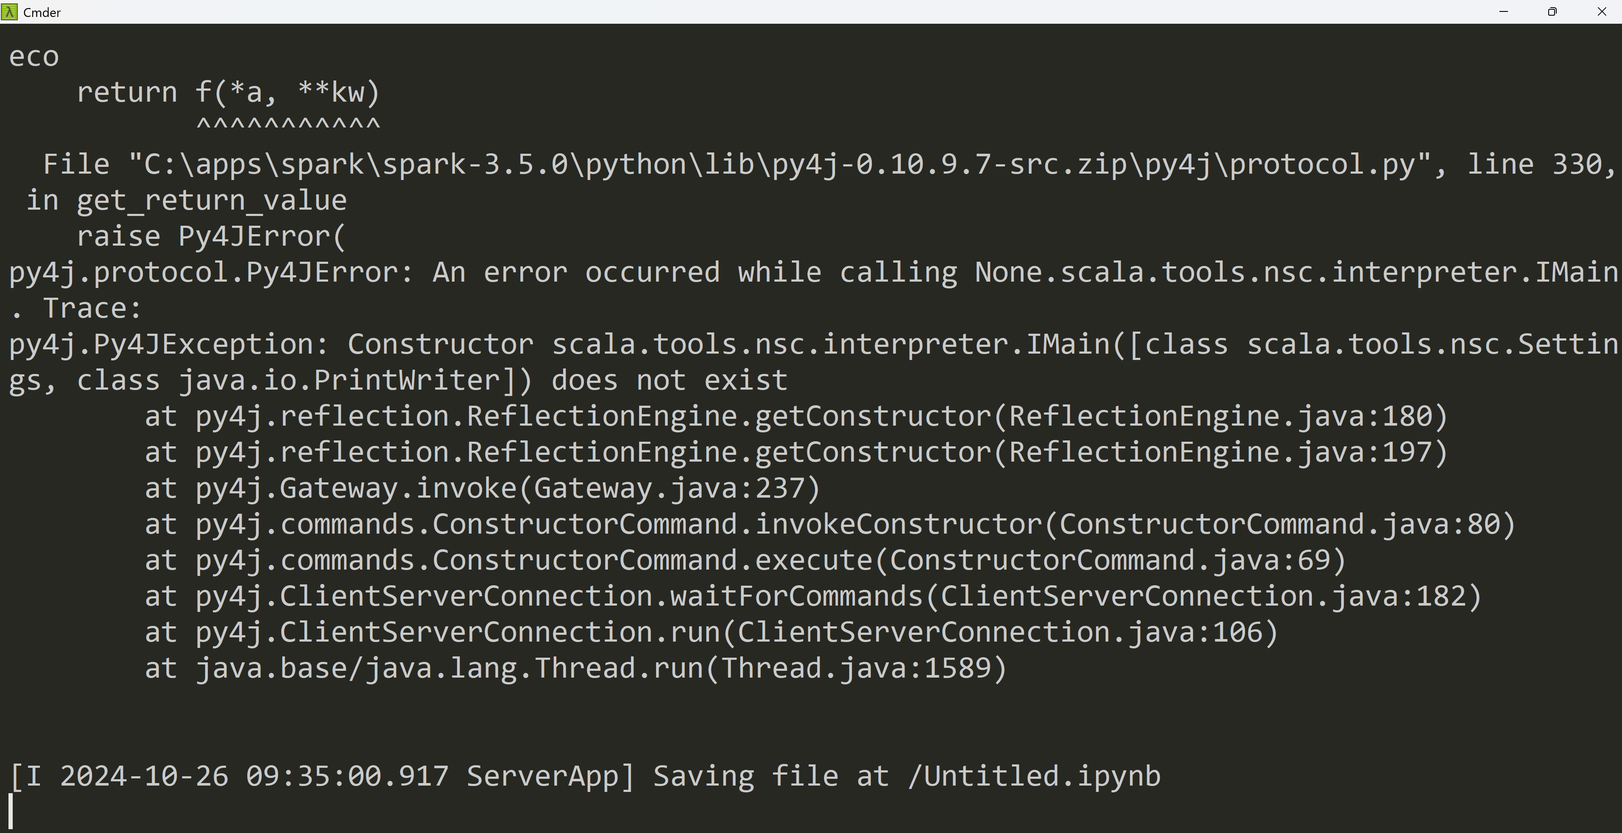
TroubleShooting ???

Slide 30
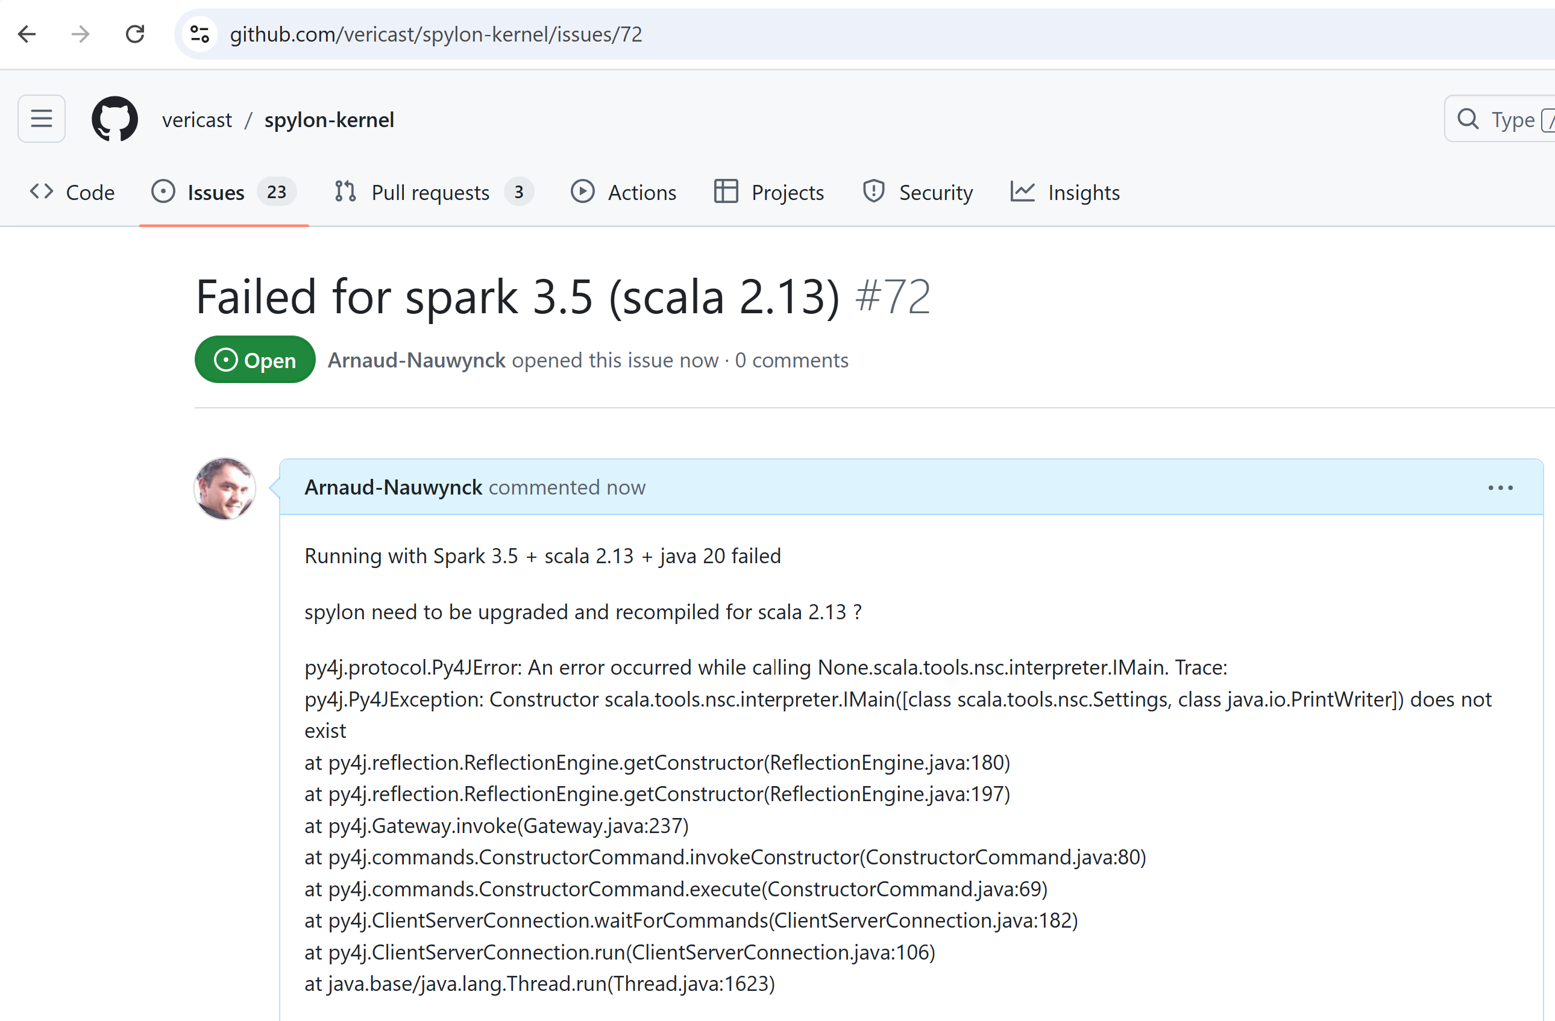
Spylon ERROR for spark 3.5

Slide 31
Step 3 alternative : kernel for pyspark (for using PySpark with Python langage)

Slide 32
TODO ... WORK IN PROGRESS

